Slide 1
Anacondas++ User Manuel

Slide 2
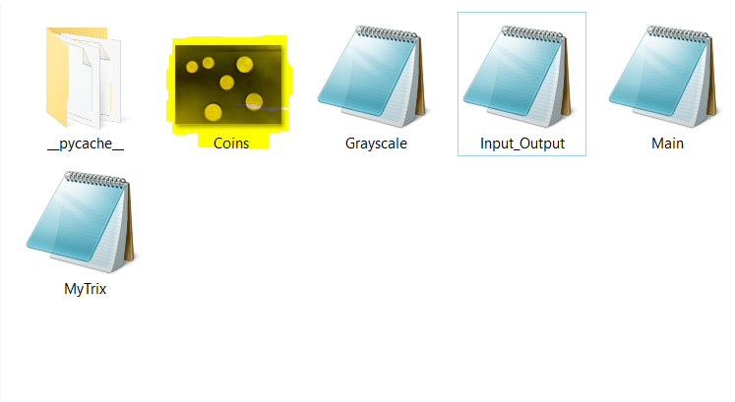
Setup
Before using the program, make sure you have placed a PNG image file into the same folder as the program, otherwise the program will not be able to find the image you wish to transform.

Slide 3
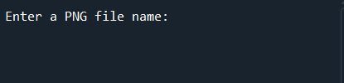


Running The Program
Upon the program run you will be asked to input a file name:
Enter the file name of the PNG image you want processed
OR

Slide 4



Running the program (cont.)
You will then be asked for what you want the processed image to be saved as
Enter your desired file name:
OR

Slide 5
Running the program (cont.)
You will then be asked what threshold value you want to use:
Enter your desired threshold value:

Slide 6
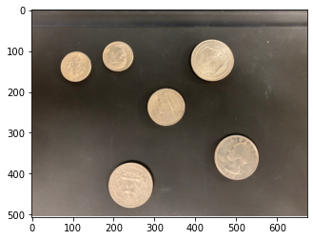
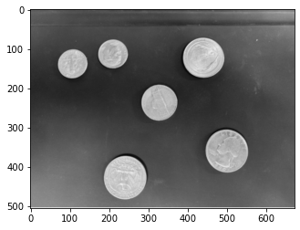
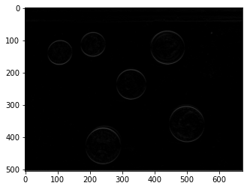

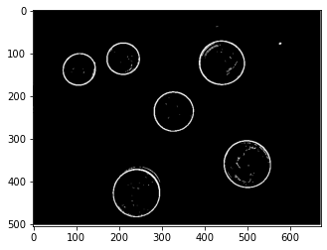
Output
Once the program has finished running you will see the plots of each transformation applied to the image

Slide 7
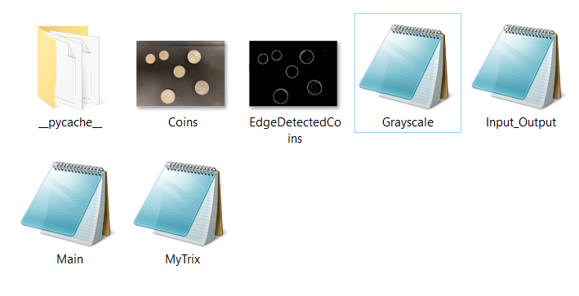
Output (cont.)
You will also see the PNG file with the name you entered in the same folder as the program and initial image

Slide 8


Examples
Input: “PurdueArch”
Output name: “PurdueArchEdge”

Slide 9
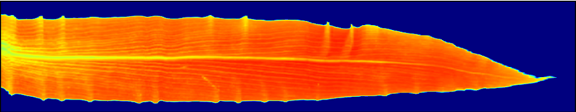
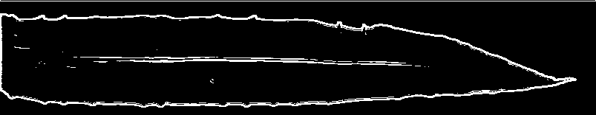
Examples(cont.)
Input: “LeafSpecSample”
Output name: “LeafEdge”

